Slide 1

Powerline Fault Detection for Partial Discharge using Deep Learning
Group Members:
L N Saaswath (19084011)
Ajitesh Pandey (19084004)
Shivam Awasthi (19085084)
Nandini Jain (19084025)
Tanmay Sharma (19085090)

Slide 2
Acknowledgement
We’d like to thank our Project Coordinator, Prof Dr.Soumya R Mohanty for guiding us through various stages of the project. It has been a learning experience for all of us, and we have been able to broaden our knowledge of both Deep Learning and Event detection in power lines.

Slide 3
Deep Learning application for event detection in a Power Network
Accurate detections of the events are crucial to bulk power system situation awareness and event investigation.Deep learning can be used to detect abnormalities in the data related to a power network. In this project, we utilize the recent advances of deep learning to build a convolutional neural network and long short-term memory model to detect faults in power lines.

Slide 4
What is Partial Discharge?
Medium voltage overhead power lines run for hundreds of miles to supply power to cities. These great distances make it expensive to manually inspect the lines for damage that doesn't immediately lead to a power outage, such as a tree branch hitting the line or a flaw in the insulator. These modes of damage lead to a phenomenon known as partial discharge — an electrical discharge which does not bridge the electrodes between an insulation system completely.
Problems caused by Partial Discharge
Partial discharges slowly damage the power line, so left unrepaired they will eventually lead to a power outage or start a fire.
If left alone, partial discharges can damage equipment to the point that it stops functioning entirely

Slide 5
Problem Statement
What?
Why Solution is needed?
How to approach?
To Detect Partial Discharge patterns in signals acquired from these power lines with a meter
By Detecting partial discharges repairs we can reduce maintenance costs and prevent power outages.
Repairs can be made before any lasting harm occurs.
We can do Feature Extraction on Signals and then feed them into the Neural Networks to do binary classification for whether the partial discharge pattern is present or not.
We can do Feature Extraction on Signals and then feed them into the Neural Networks to do binary classification for whether the partial discharge pattern is present or not.

Slide 6
Classical modes of Detection
Partial Discharges can be detected by measuring the emissions they give off,some of which are Ultrasonic sound and Transient Earth Voltages(TEV and UHF energy)
We realized by doing some research that it is possible to enhance the modes of detection by Deep Learning after doing some pre processing

Slide 7
Approach
We’ve taken data which consists of signals containing 800,000 measurements of a power line's voltage, taken over 20 milliseconds.
We’ll do some Feature Extraction on these signals and then feed them into a NN.
We’ll use the NN to do binary classification for whether partial discharge is present or not?

Slide 8
Data Overview and Source
Each signal contains 800,000 measurements of a power line's voltage, taken over 20 milliseconds. As the underlying electric grid operates at 50 Hz, each signal covers a single complete grid cycle. The grid itself works on a 3-phase power scheme, and all three phases are measured simultaneously.
The data is collected in the form of signals from the powerlines by using a meter designed at the ENET Centre at VŠB.

Slide 9
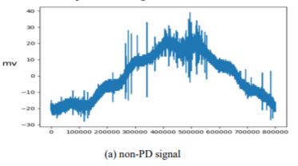
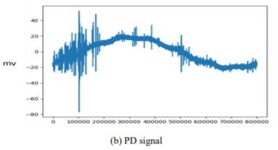
Sample signal records of the two classes
(a) Partial Discharge, (b) non-partial discharge signals from the dataset

Slide 10
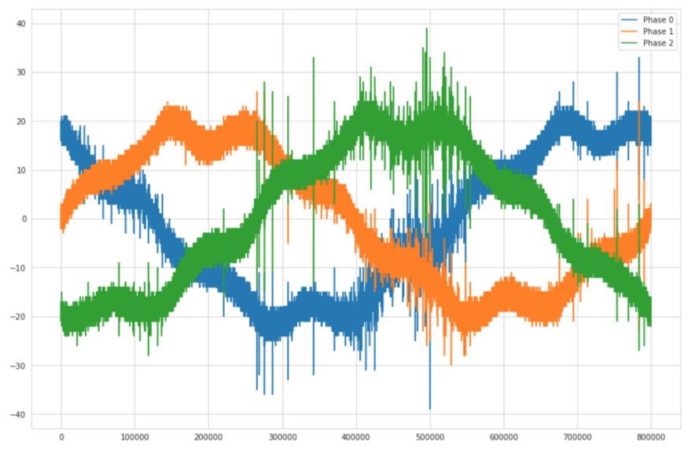
Visualisation of sample signals of the 3-phases captured in the same time frame from the dataset

Slide 11
The Model
The base model utilises a CNN to extract features from the signal, and upon this, an LSTM is added to get temporal dependencies of the signal.
The problem approached here is binary classification(Partial Discharge or not) and for an instance in the model, we consider a fraction of a single signal entry from the dataset, since 800,000 measurements from just one signal is difficult to compute in one go. The signal has been preprocessed and normalised before sending to the model.
To this primitive model, additional features are added apart from the signals are the denoised signals(by FFT), the sum of each phase's absolute values over time, and low pass and high pass filtered signals. These features added after denoising with FFT play a vital role in increasing the accuracy of the model.

Slide 12
Fast Fourier transform
The Fourier Transform of an 1D signal x of length n is following :
The idea is to represent the signal in the complex space, It is roughly a sum of sinusoidal functions. And there is one coefficient per frequency present in the signal.
The frequency takes the following values :
f = (1/dn) [0,1,.....(n/2)-1, -n/2,....,-1] if n is even
f = (1/dn) [0,1,.....(n-1)/2, -(n-1)/2,...,-1] if n is odd

Slide 13
Denoising Data using FFT
The FFT is one of the most important algorithms that have changed the world fundamentally. In data science, the FFT can be used to denoise data. The algorithm is nontrivial but well-known and it’s also well packed in many programming languages.
Denoising Algorithm:
The denoising steps are the following :
Apply the fft to the signal
Compute the frequencies associated with each coefficient
Keep only the coefficients which have a low enough frequency (in absolute)
Compute the inverse fft

Slide 14
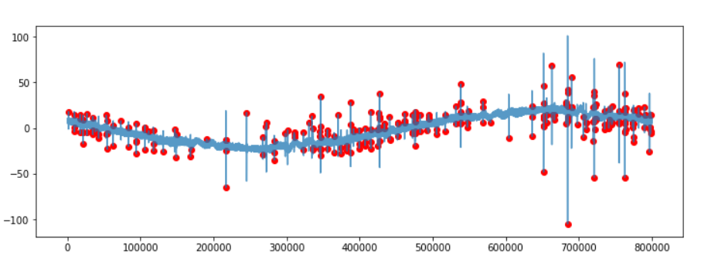
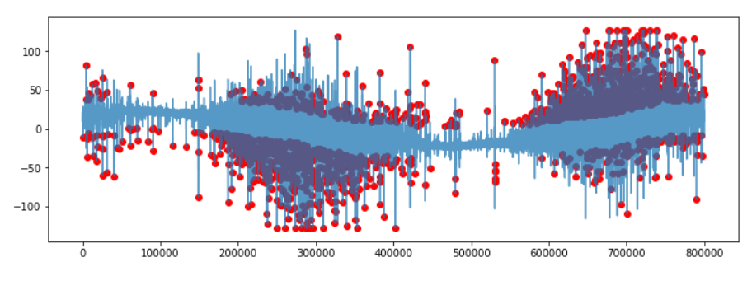
Visualising the signal with the peaks that need to be filtered out

Slide 15
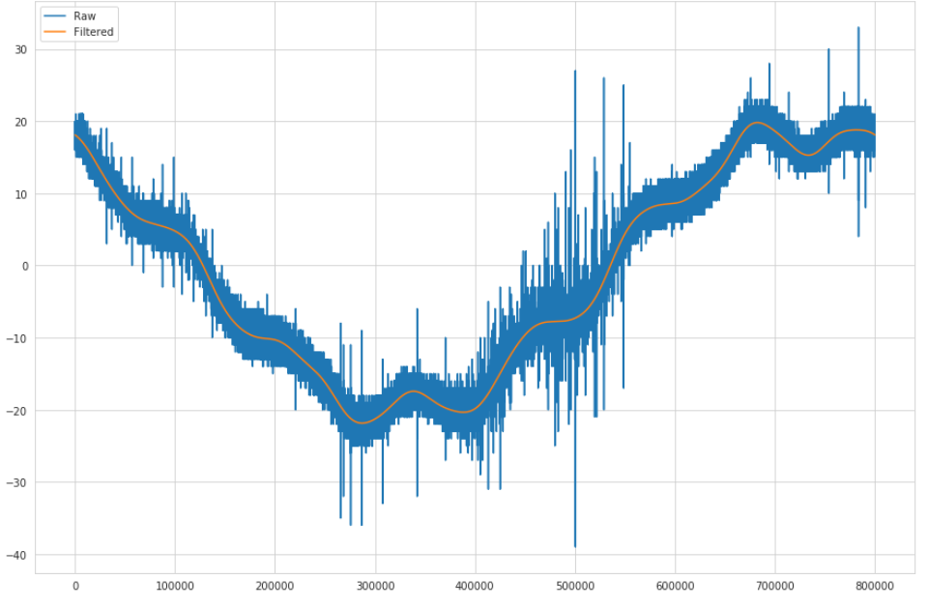
Raw signal and Filtered phase signal with desired threshold using FFT

Slide 16
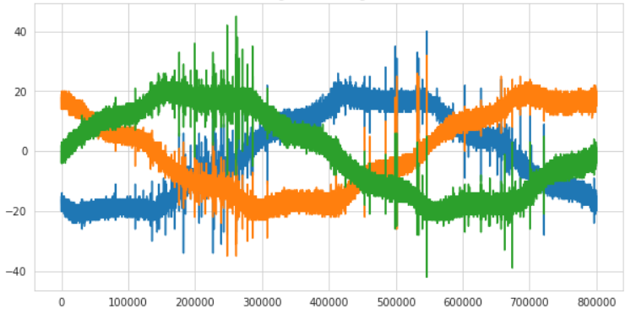
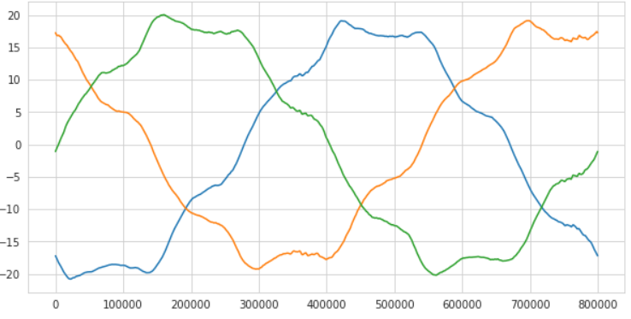
One 3-phase signal entry from the dataset
The 3-phase Signal after Denoising with FFT
Denoising with FFT

Slide 17
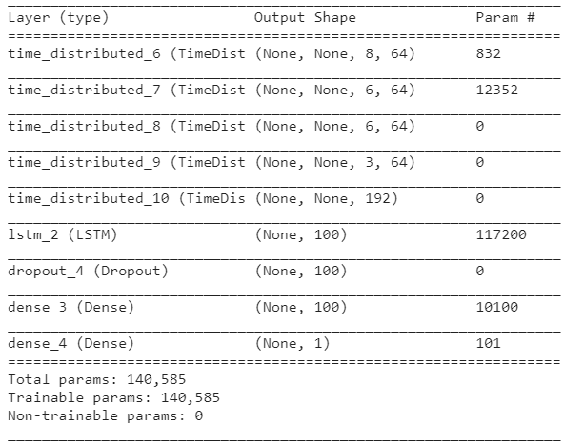
Summary of the model

Slide 18
Results obtained from model
If we use the initial data without doing any pre-processing and feature engineering we would get an AUC(Area Under Curve-for binary classification) score of about 0.8-0.87 and 0.45LB score. This is because it becomes very difficult for our model to deal with the noise present in the signals.
However, after doing denoising with the help of FFT, we were able to
increase AUC score to 0.92-0.95 and 0.51LB score.

Slide 19
Conclusion
By retraining the model three times, we were able to get this accuracy.
Further improvements may be made if we increase the number of epochs and play around with the threshold.
Perhaps if we use the data obtained from the spectral analysis as extra features, we can further increase the accuracy.

Slide 20
Other models which can Detect partial discharge as well
Logistic Regression:
We can first use stratified k fold cross-validation to find the best hyperparameter and then train our model using the best hyperparameter.
Random Forest Classifier can be used as well.
There are various other Thresholding methods for denoising the signals but we chose fft transform because it was working well with our dataset and model.

Slide 21
Future Prospect
We have used the Knowledge of Deep Learning (CNN+LSTM) in this project to detect partial discharge and overcome fault detection in signals.
We are currently using fft to split the signals into high and low frequency channels. We can further improve the results by using spectral analysis and adding them as additional features. Further, we can enhance the experiment with cross-validation, adaptive learning rate, early stopping, ensembling etc.
There are many organisations which are working on detecting these faults by using smart meters equipped with these types of models.

Slide 22
References
https://arxiv.org/abs/1905.01588
https://arxiv.org/abs/2011.02336
https://realpython.com/python-scipy-fft/
https://bigdata.seas.gwu.edu/data-set-5-vsb-power-line-fault-detection-data-set/

Slide 23
Thank You

